Slide 1



HOSPITALITY FINANCE ANALYTICS
Meet the team:
Mr. Abhisek Sahu
Mr. Vishal Gundu
Ms. Tejaswini P
Mr. Atul Pawar
Mr. Shubham B Bagwe
Mr. Nishant Sujeet Badge

Slide 2


About:
For the project of hospitality finance analysis, we worked on the data provided by the institute.
First of all, we have gone through the data, and the aim is to develop an interactive dashboard on either Tableau, Power BI, or Advance Excel.
In that we have followed the following stages to complete the dashboard.
Load the data
Transform the data
Data modeling
Developing the KPIs
Created columns or measures in Power BI and calculated fields and parameters in Tableau
Developed the visualizations and created the Dashboard

Slide 3
OBJECTIVE
The primary goal of this project is to analyze the seasonality of Hospitality Financial data and create adequate plans to know the total revenue, total department expenses, and RevPAR.
Data Information
We have one dataset which is Finance Dataset (Hospitality Finance).
In Hospitality Finance, there are 32297 Rows and 40 Columns.

Slide 4
DATA PROCESSING:
1. Data Understanding: The key to success on any data project is a thorough understanding of the data. As a result, we took the time to learn about your company's data model and domain.
2. Data Cleaning: After learning about your company, we cleaned up the accessible datasets and considered what an ideal dataset for this topic would look like.
3. Data Modelling: After confirming that the data was clean for analysis, we needed to process and model it into a dataset capable of precisely answering the business questions and producing the required outcomes.
4. Data Analysis: We used our analytical capabilities to identify insights from our new dataset and to create visualizations to describe the insights
5. Uncover Insights:. Finally, we applied these insights to create business decisions and recommendations for next steps.

Slide 5
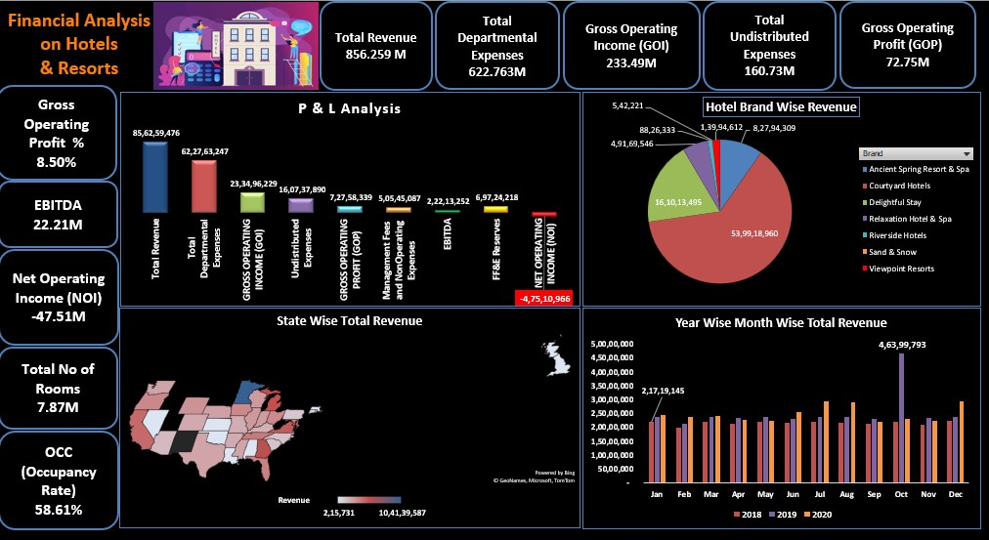
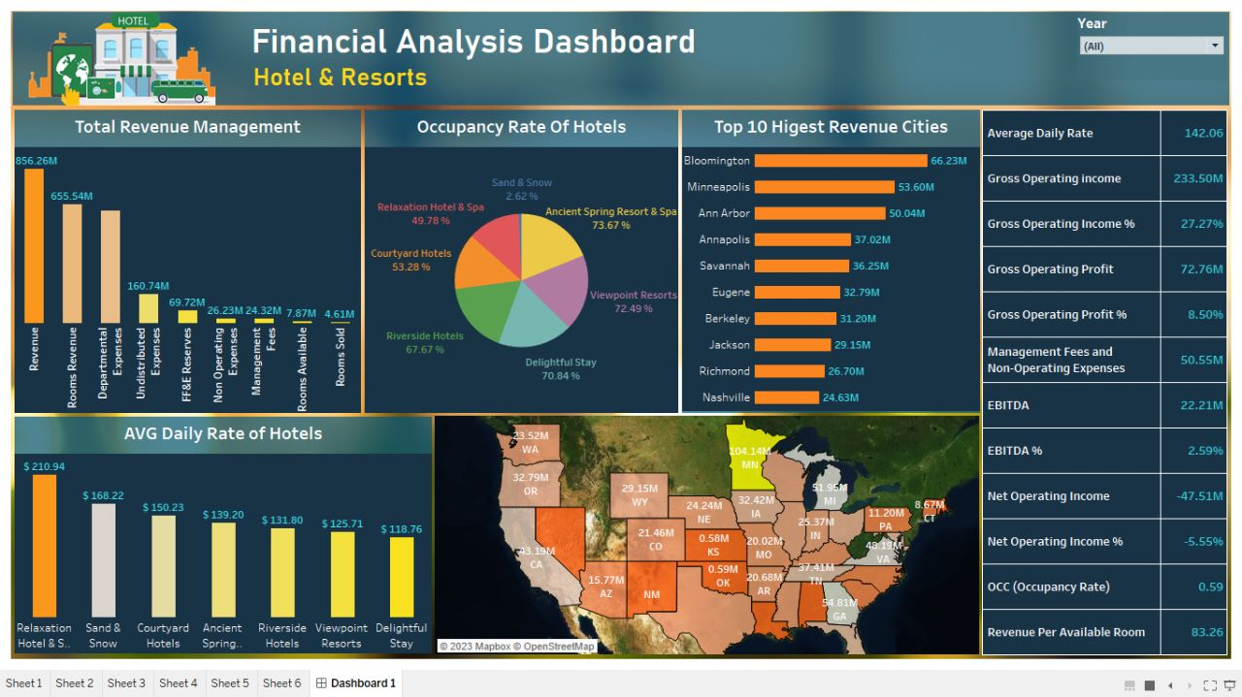
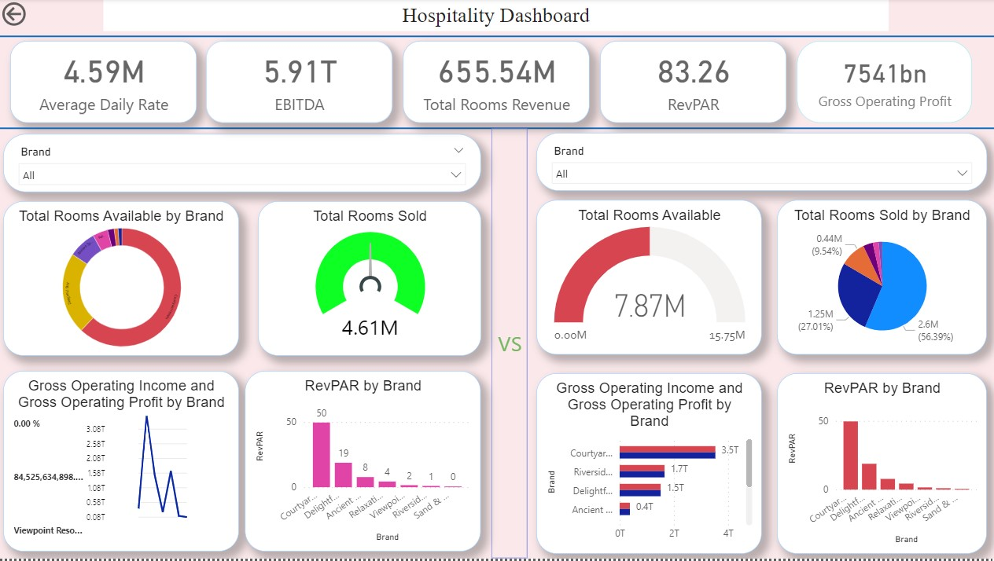
EXCEL DASHBOARD
TABLEAU DASHBOARD
POWER BI DASHBOARD

Slide 6
THANK YOU!

